Slide 1
Compiler Design

Slide 2
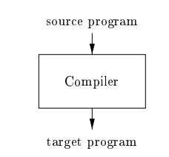
Compiler
A compiler is a program that reads a program written in a source language.
It translates this program into an equivalent program in a target language.
During translation, the compiler also detects and reports errors present in the source program.
The output is a translated program that can be executed independently.

Slide 3

If the target program is an executable machine-language program, it can then be called by the user to process inputs and produce outputs.

Slide 4
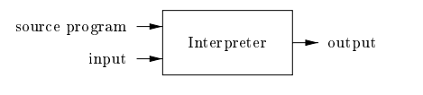
Interpreter
An interpreter does not produce a translated target program.
Instead, it directly executes the operations specified in the source program.
Execution happens line by line or instruction by instruction.
No separate output program is generated; the interpreter acts as the executor of the source code.

Slide 5
Compiler
Produces a machine-language target program.
The generated program runs much faster when mapping inputs to outputs.
Fast execution because translation happens once, before running the program.
Interpreter
Directly executes the source program, statement by statement.
Generally provides better error diagnostics.
Errors are easier to detect because execution happens line by line.

Slide 6
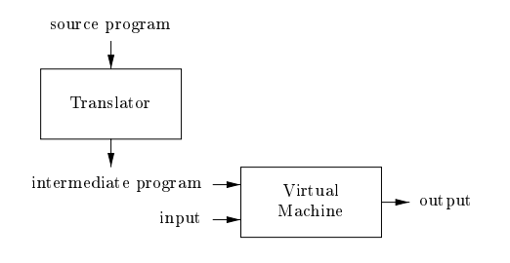
Compilation + Interpretation
Java uses a hybrid approach combining both compilation and interpretation.
A Java source program is first compiled into bytecode, an intermediate form.
The Java Virtual Machine (JVM) then interprets the bytecode.

Slide 7
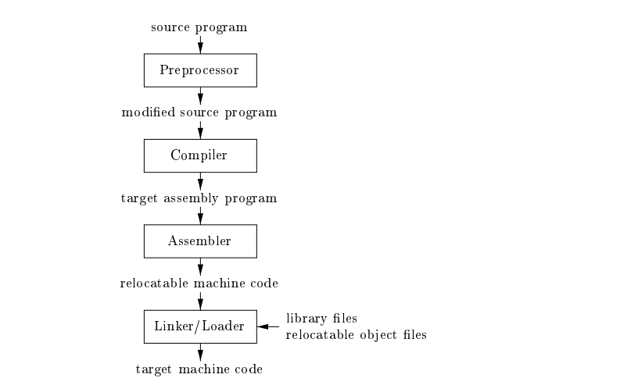
Language Processing System

Slide 8
Preprocessor
Collects and prepares the source program before compilation.
Expands macros (shorthand notations) into full source statements.
Produces a modified source program as input to the compiler.

Slide 9
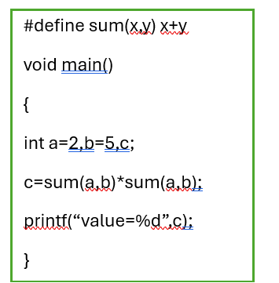
Whenever sum(a,b) is seen it is replaced with a+b
So the line c=sum(a,b)*sum(a,b) will be replaced with c=a+b*a+b, whose result after evaluation will be c=17

Slide 10
Assembler
Converts the assembly program into relocatable machine code.
Output: object files that can be placed at different memory locations.
Translates mnemonics → opcodes (e.g., ADD → machine instruction).
Replaces symbolic names (labels, variables) with actual memory addresses.
Checks for syntax and semantic errors in assembly code.

Slide 11
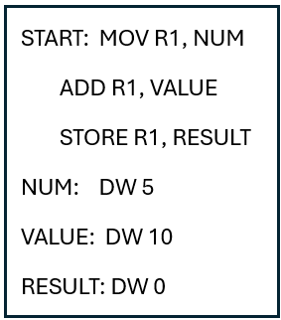
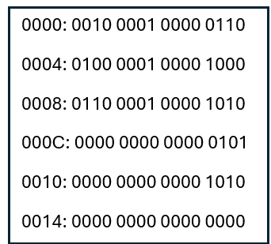
Converts code like this
To machine understandable

Slide 12
Linker
Combines multiple relocatable object files and library files.
Resolves external references, such as functions or variables located in other files.
Produces a single executable program.
Loader
Loads the executable program into memory.
Prepares it for execution by assigning memory locations and setting up the environment.

Slide 13
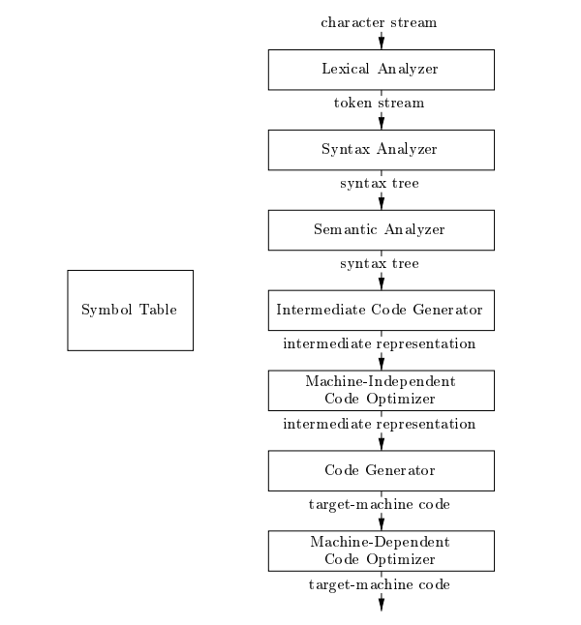
Phases of A Compiler

Slide 14
Lexical Analyzer
Reads the stream of characters in the source program.
Groups characters into meaningful units called lexemes.
Produces tokens for the syntax analyzer
Semantic Analyzer
Uses the syntax tree and symbol table to check semantic consistency.
Ensures the program follows the language rules (types, declarations, scope).
Collects type information and stores it in:
  the syntax tree, or
  the symbol table
Information collected is later used in intermediate code generation.

Slide 15
Intermediate Representations (IR)
A compiler may create one or more intermediate representations.
IR helps bridge the gap between high-level language and machine code.
Syntax trees are a common intermediate form.
Used during syntax analysis and semantic analysis.
Converts validated syntax tree to a machine-independent IR.

Slide 16
Machine-Independent Code Optimization
Improves the intermediate code so better target code is produced.
“Better” may mean:
  faster execution
  smaller code size
  lower power consumption

Slide 17
Code Generator
Takes the intermediate representation as input.
Maps it to the target language (often machine code).
Assigns registers or memory locations to variables.
Converts IR instructions into machine instructions that perform the same actions.

Slide 18
Role of the Symbol Table
Records variable names used in the source program.
Stores attributes such as:
  Data type
  Storage information
  Scope (where the variable can be used)
  For procedures:
    Number and types of arguments
    Calling method (call by value or call by reference)
    Return type

Slide 19
Lexical Analysis
First phase of a compiler; reads input characters of the source program
• Groups characters into lexemes and produces a sequence of tokens
• Sends tokens to the parser for syntax analysis
• Interacts with the symbol table
Inserts identifiers when discovered
May read identifier information to determine the correct token
• Parser usually calls the lexical analyzer using getNextToken()
• Performs extra tasks during scanning:
– Removes comments
– Removes whitespace (blank, newline, tab)
– Tracks line numbers for error reporting
– May insert error messages into a copy of the source program
– May expand macros if a macro-preprocessor is used

Slide 20
Lexical analyzers are often divided into two stages:
1.Scanning (Simple tasks)
Performs operations that do not require tokenization such as:
• Removes comments
• Compresses multiple whitespace characters into one
2. Lexical Analysis Proper (Main task)
  • Receives cleaned input from the scanner
  • Identifies lexemes
  • Produces tokens for the parser

Slide 21
Lexeme: A lexeme is the actual sequence of characters in the program that matches a pattern.
Example: int marks = 90;
"int" matches pattern for keyword
"marks" matches pattern for identifier
"=" matches pattern for assignment operator
"90" matches pattern for number
";" matches pattern for semicolon
Lexeme is the actual text that appears in the source program.

Slide 22
Tokens
A token is a pair consisting of a token name and an optional attribute value
Token name is symbol representing a lexical unit.
Example: sum = a + 10;
ID, attribute = “sum”
ASSIGN
ID, attribute = “a”
PLUS
NUM, attribute = 10
SEMICOLON

Slide 23
Keywords – if, while, return, etc.
Identifiers – variable names, function names
Literals – numbers, characters, strings
Operators -+,-,*,..
Punctuation – (,),{, , ; ,

Slide 24
Patterns
A pattern describes what form lexemes of a token can take.
For keywords, the pattern is the exact word.
Example:
Pattern for token IF is "if".
For identifiers, pattern is a rule that matches many strings.
Example pattern for identifiers:
letter (letter | digit)*
This matches:
x, total1, value123, abc

Slide 25
For numbers, pattern could be:
digit digit*
This matches:
5, 23, 7890
the rule or template used to recognize lexemes.

